Slide 1
Chapter 3 Brute Force
University of Bahrain

Slide 2
Plan
Introduction
Selection Sort
Bubble Sort
Sequential Search
String Matching
Closest pair
Exhaustive Search

Slide 3
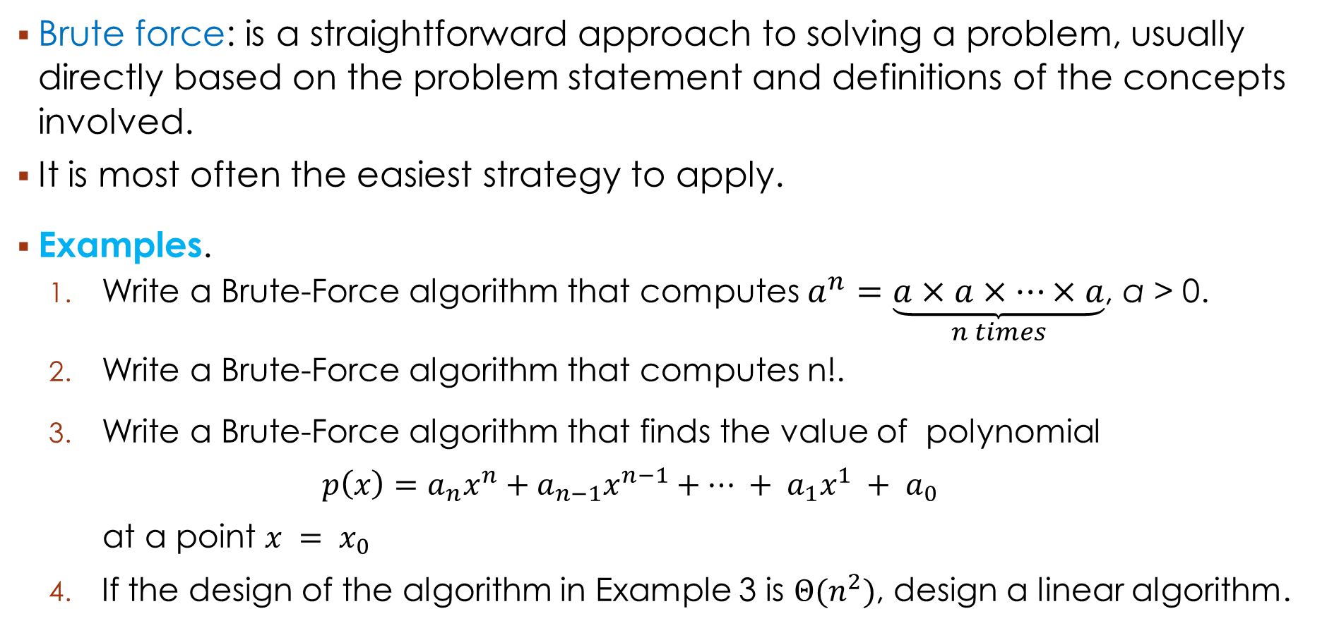
1. Introduction
Brute force: is a straightforward approach to solving a problem, usually directly based on the problem statement and definitions of the concepts involved.
It is most often the easiest strategy to apply.
Examples.
Write a Brute-Force algorithm that computes $a^{n}=\underset{n times}{\underbrace{a×a×…×a}}$, a > 0.
Write a Brute-Force algorithm that computes n!.
Write a Brute-Force algorithm that finds the value of polynomial
$$p\left(x\right)=a_{n}x^{n}+a_{n−1}x^{n−1}+… + a_{1}x^{1} + a_{0}$$
at a point $x = x_{0}$
If the design of the algorithm in Example 3 is $Θ(n^{2})$, design a linear algorithm.

Slide 4
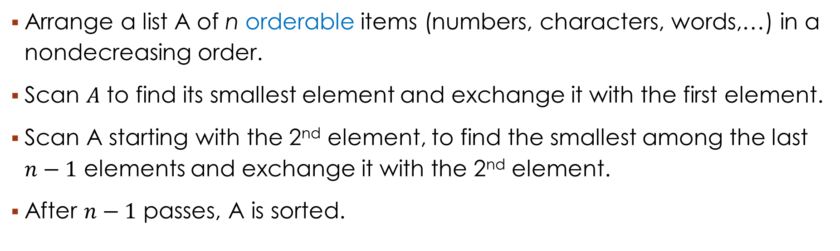
2. Selection sort
Arrange a list A of n orderable items (numbers, characters, words,…) in a nondecreasing order.
Scan $A$ to find its smallest element and exchange it with the first element.
Scan A starting with the 2nd element, to find the smallest among the last $n−1$ elements and exchange it with the 2nd element.
After $n−1$ passes, A is sorted.
$$A_{0}≤A_{1}{{≤…≤A}_{i−1} | A}_{i},…,A_{min},…,A_{n−1}$$
In their final positions The last $n−i$ elements

Slide 5
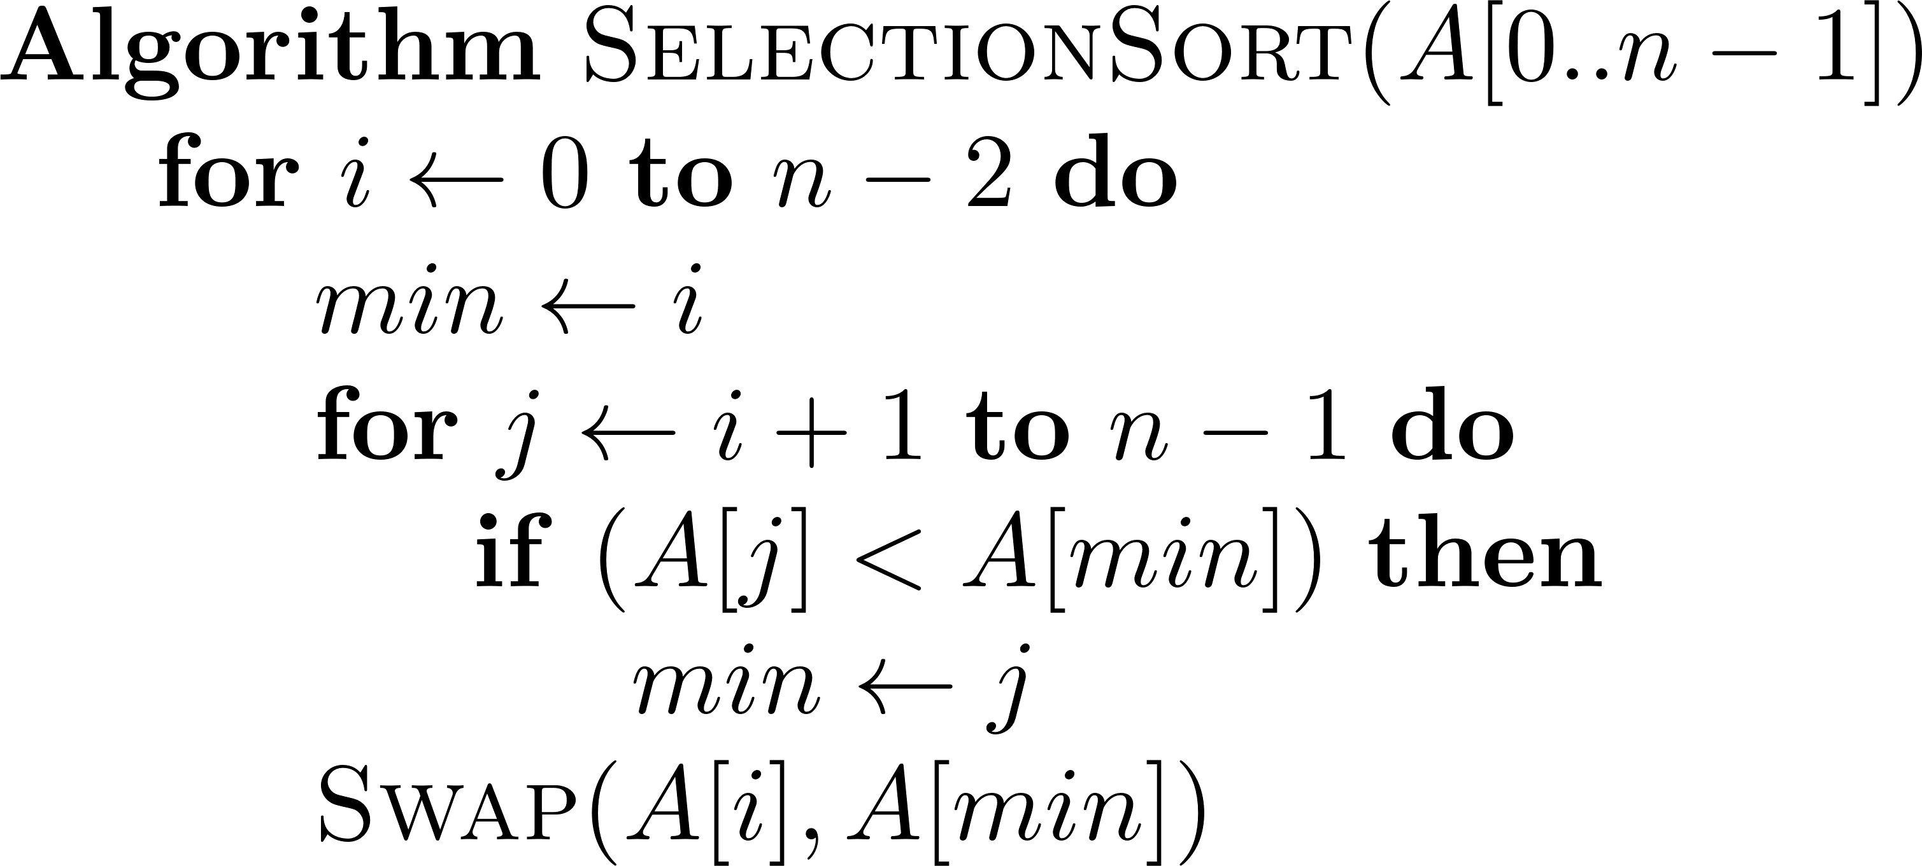
2. Selection sort – pseudocode & Example
EXAMPLE
89 45 68 90 29 34 17
17 45 68 90 29 34 89
17 29 68 90 45 34 89
17 29 34 90 45 68 89
17 29 34 45 90 68 89
17 29 34 45 68 90 89
17 29 34 45 68 89 90
PSEUDOCODE
$$A_{0}≤A_{1}{{≤…≤A}_{i−1} | A}_{i},…,A_{min},…,A_{n−1}$$
In their final positions The last $n−i$ elements

Slide 6
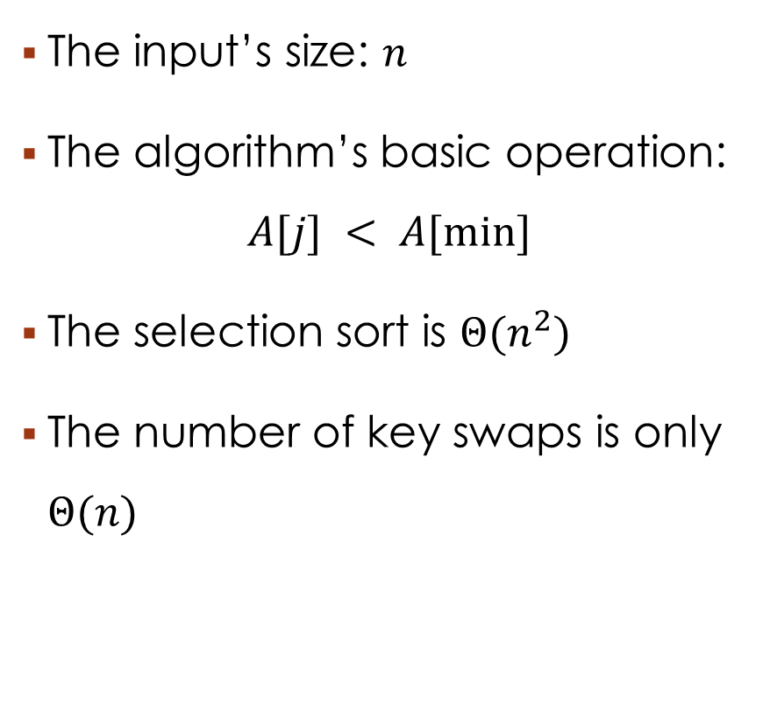
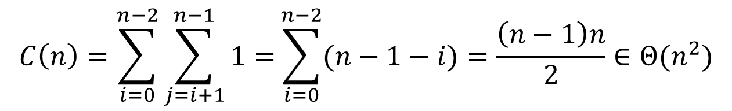
2. Selection sort - Analysis
PSEUDOCODE
The input’s size: $n$
The algorithm’s basic operation: $A[j] < A[min]$
The selection sort is $Θ(n^{2})$
The number of key swaps is only $Θ(n)$
$$C\left(n\right)=\sum_{i=0}^{n−2}{\sum_{j=i+1}^{n−1}{1}=}\sum_{i=0}^{n−2}{(n−1−i)=\frac{\left(n−1\right)n}{2}∈Θ(n^{2})}$$

Slide 7
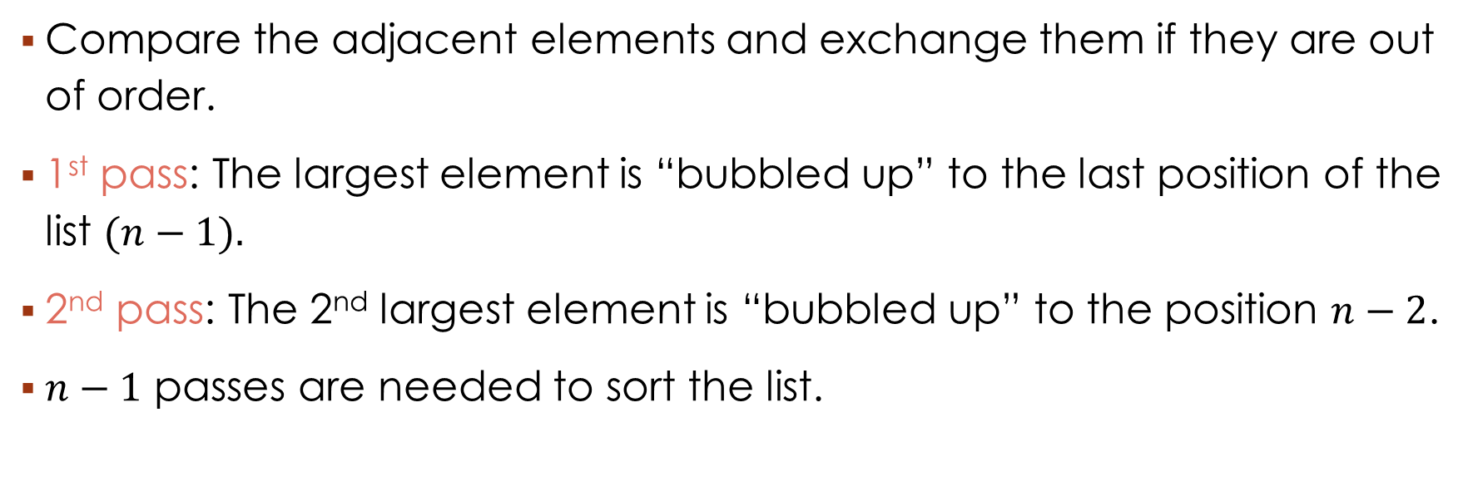
3. Bubble sort
Compare the adjacent elements and exchange them if they are out of order.
1st pass: The largest element is “bubbled up” to the last position of the list $(n−1).$
2nd pass: The 2nd largest element is “bubbled up” to the position $n−2$.
$n−1$ passes are needed to sort the list.
?
$$A_{0},…,A_{j}{{ ↔ A}_{j+1},…, A}_{n−i−1}|A_{n−i}≤…≤A_{n−1}$$
in their final positions

Slide 8
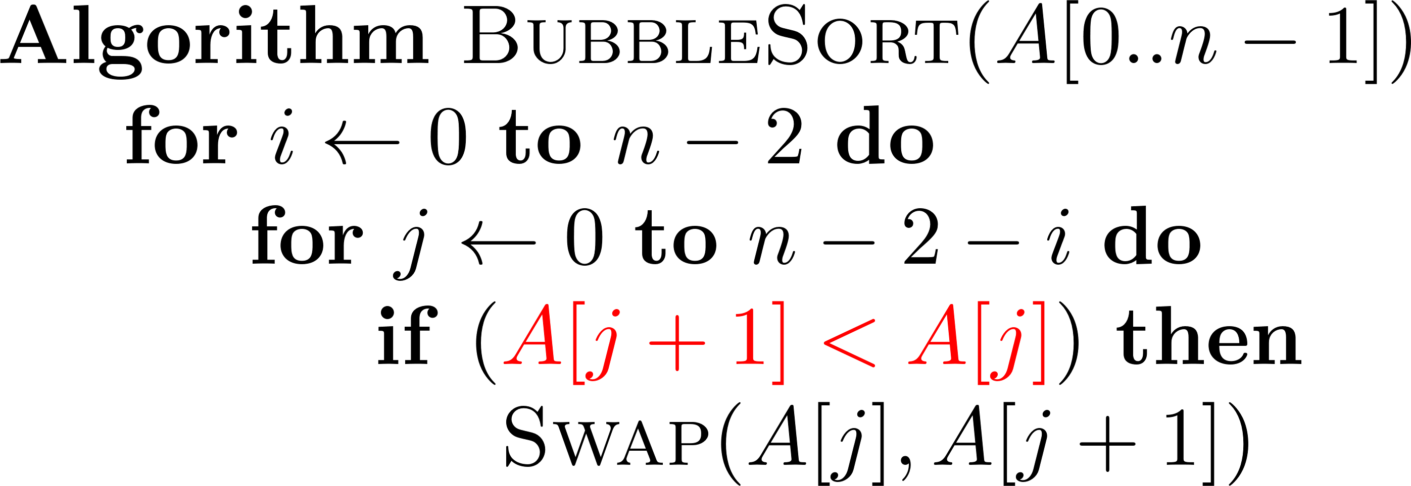
3. Bubble sort - pseudocode & Example
89 45 68 90 29 34 17
45 89 68 90 29 34 17
45 68 89 90 29 34 17
45 68 89 29 90 34 17
45 68 89 29 34 90 17
45 68 89 29 34 17 90
45 68 89 29 34 17 90
45 68 29 89 34 17 90
45 68 29 34 89 17 90
45 29 68 34 17 89 90
PSEUDOCODE
?
?
?
?
1st pass
?
?
?
?
?
?
$$A_{0},…,A_{j}{{ ↔ A}_{j+1},…, A}_{n−i−1}|A_{n−i}≤…≤A_{n−1}$$
?
in their final positions
?
2nd pass

Slide 9
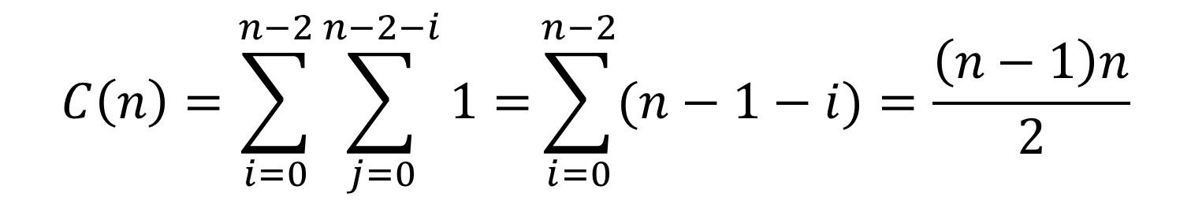
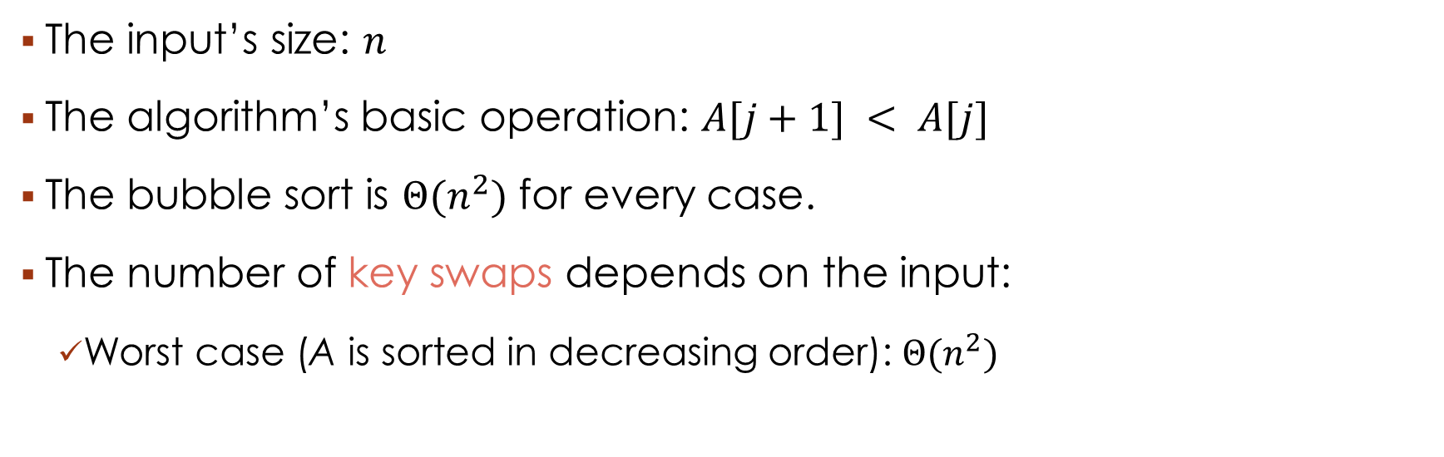
3. Bubble sort - Analysis
The input’s size: $n$
The algorithm’s basic operation: $A[j+1] < A[j]$
The bubble sort is $Θ(n^{2})$ for every case.
The number of key swaps depends on the input:
Worst case (A is sorted in decreasing order): $Θ(n^{2})$
$$C\left(n\right)=\sum_{i=0}^{n−2}{\sum_{j=0}^{n−2−i}{1}=}\sum_{i=0}^{n−2}{(n−1−i)=\frac{\left(n−1\right)n}{2}}$$

Slide 10
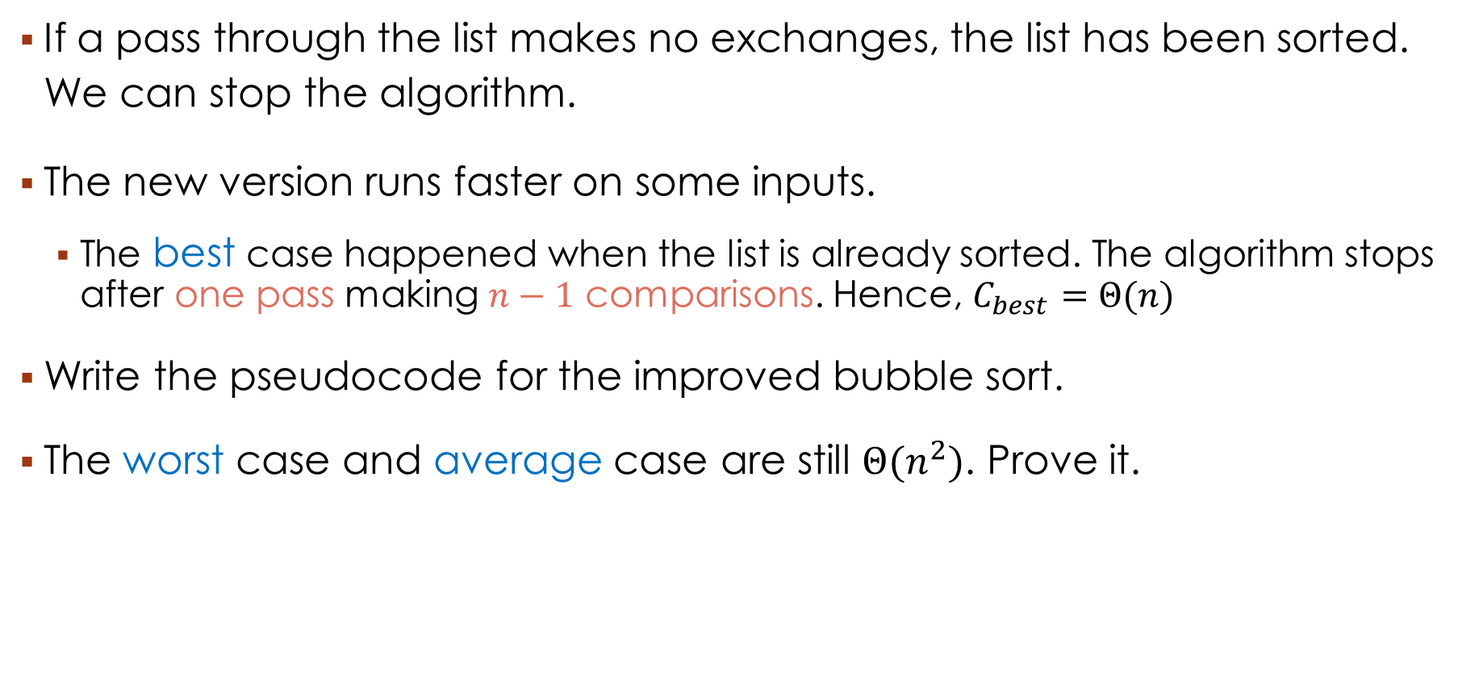
3. Bubble sort – Improved Version
If a pass through the list makes no exchanges, the list has been sorted. We can stop the algorithm.
The new version runs faster on some inputs.
The best case happened when the list is already sorted. The algorithm stops after one pass making $n−1$ comparisons. Hence, $C_{best}=Θ(n)$
Write the pseudocode for the improved bubble sort.
The worst case and average case are still $Θ(n^{2})$. Prove it.

Slide 11
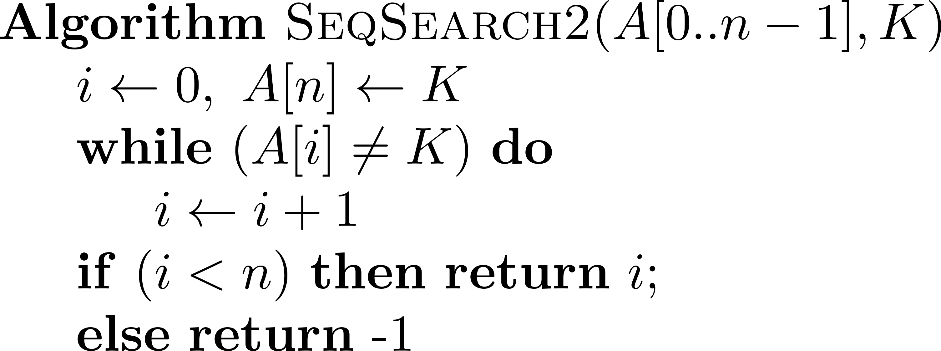
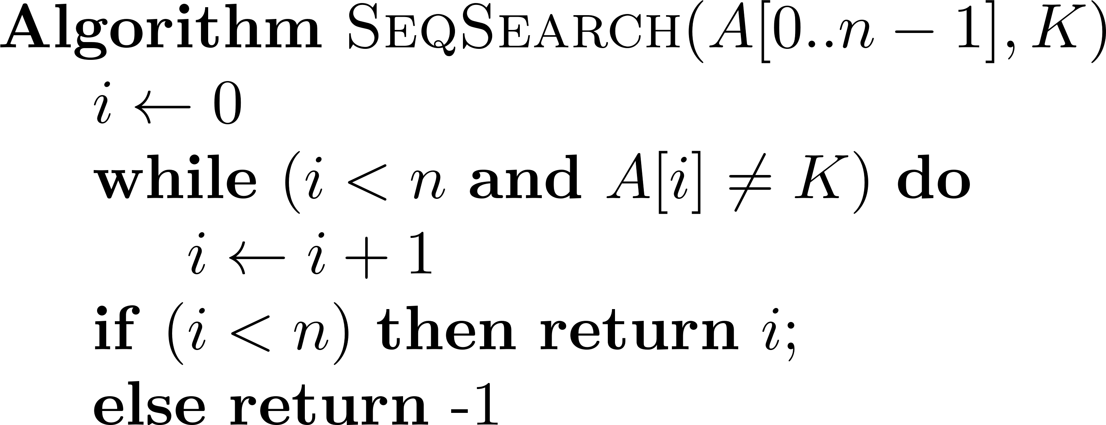
4. Sequential search
The algorithm searches for a given value K in an array A[0..n-1] and returns the index of the first element in A that matches K or -1 if there are no matching elements.
If we append the search key K to the end of the list, the search for K will have to be successful, and eliminate the end of list check altogether.
PSEUDOCODE
PSEUDOCODE
Modify the algorithm to search for K if A is sorted in increasing order.

Slide 12
5. String Matching
Example: Find the pattern NOT in the text NOBODY NOTICED HIM.
0 | 1 | 2 | 3 | 4 | 5 | 6 | 7 | 8 | 9 | 10 | 11 | 12 | 13 | 14 | 15 | 16 | 17
N | O | B | O | D | Y | _ | N | O | T | I | C | E | D | _ | H | I | M
N | O | T
 | N | O | T
 |  | N | O | T
 |  |  | N | O | T
 |  |  |  | N | O | T
 |  |  |  |  | N | O | T
 |  |  |  |  |  | N | O | T
 |  |  |  |  |  |  | N | O | T

Slide 13
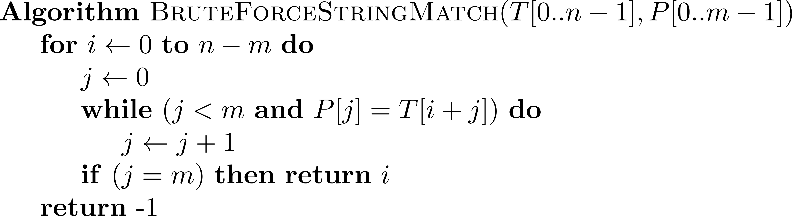
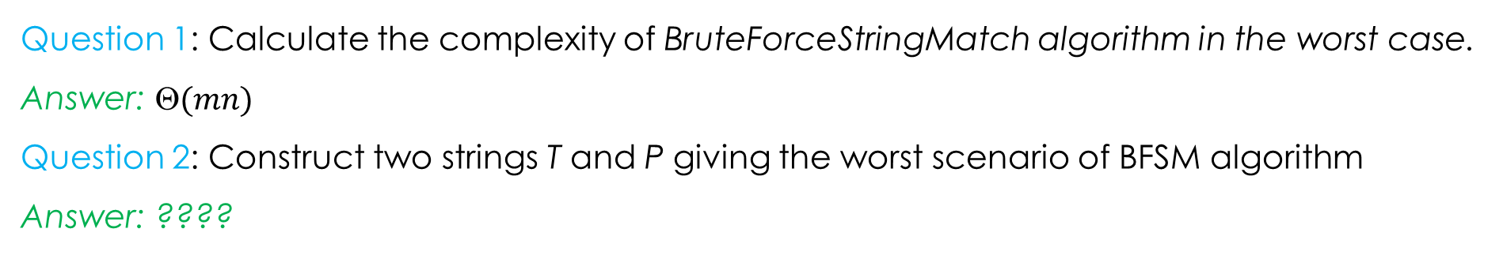
5. String Matching
Question 1: Calculate the complexity of BruteForceStringMatch algorithm in the worst case.
Answer: $(mn)$
Question 2: Construct two strings T and P giving the worst scenario of BFSM algorithm
Answer: ????

Slide 14
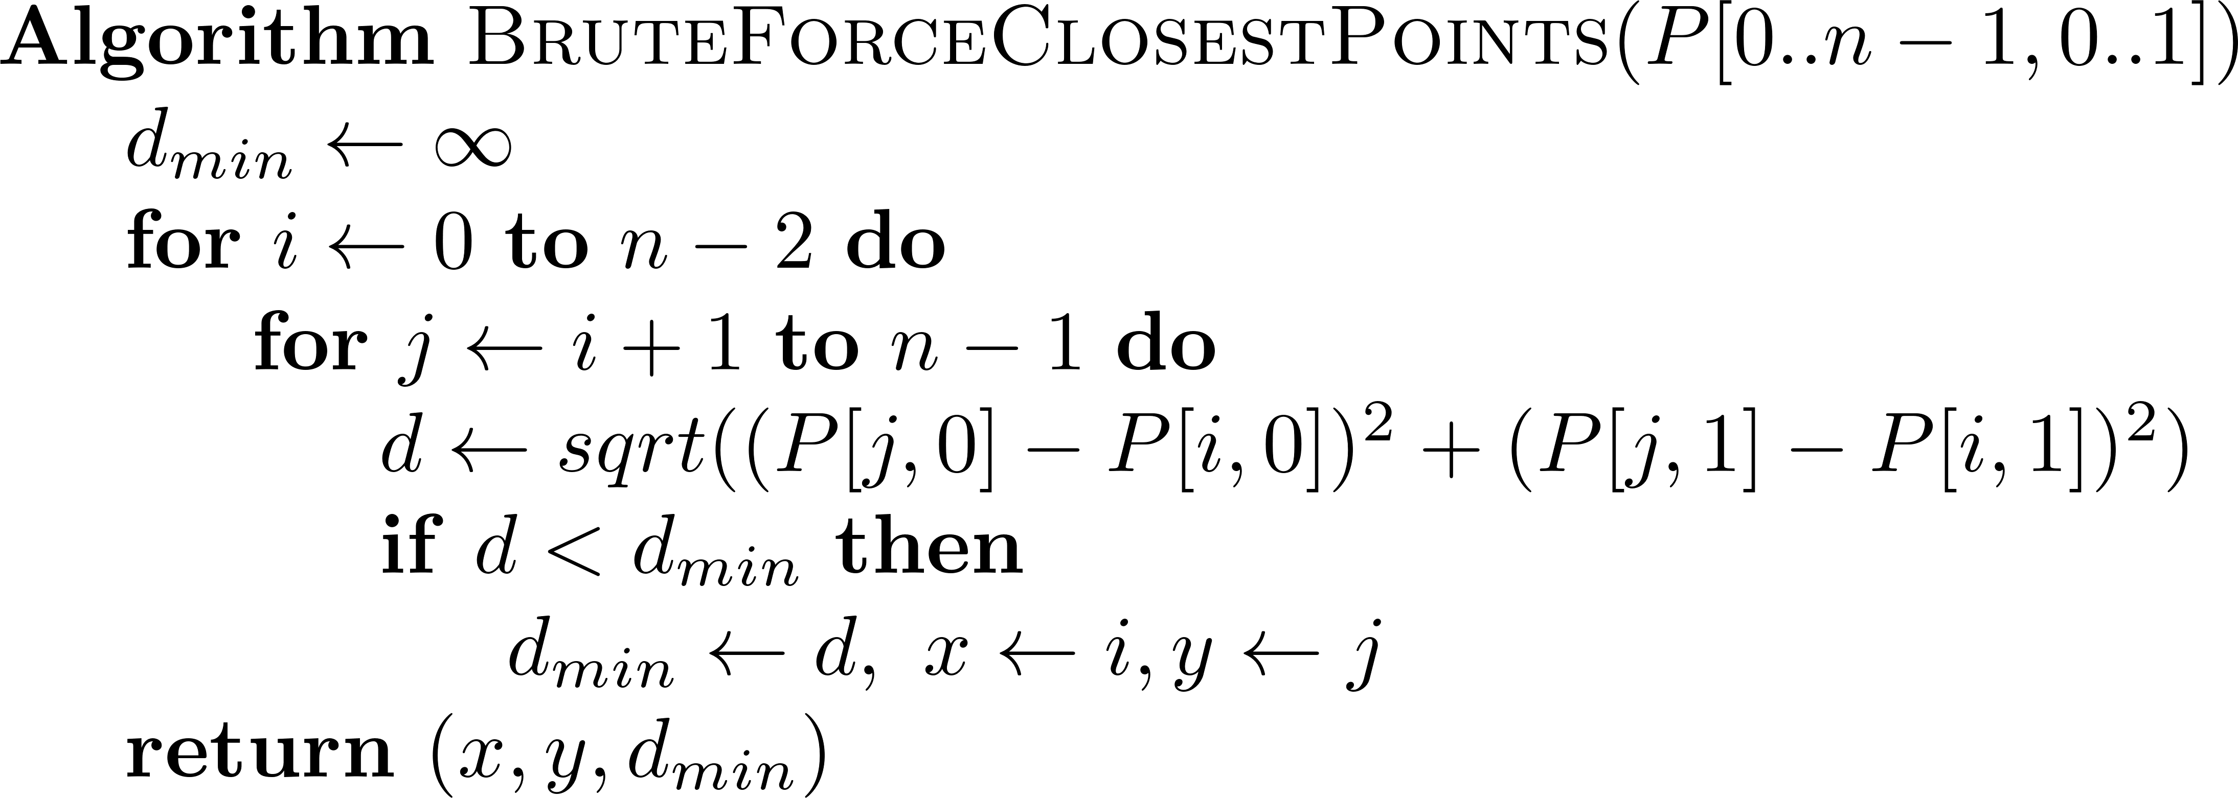

6. closest-pair
Given two points p₁(x₁, y₁) and p₂(x₂, y₂) the distance between them is:
$$d\left(p_{1},p_{2}\right)=\sqrt{{(x_{2}−x_{1})}^{2}+{(y_{2}−y_{1})}^{2}}$$
Problem: Find the two closest points in a set of $n$ points.
Input: A matrix of $n$ rows and 2 columns representing the coordinates of $n$ points.
Output: the indices of the closest pair of points

Slide 15
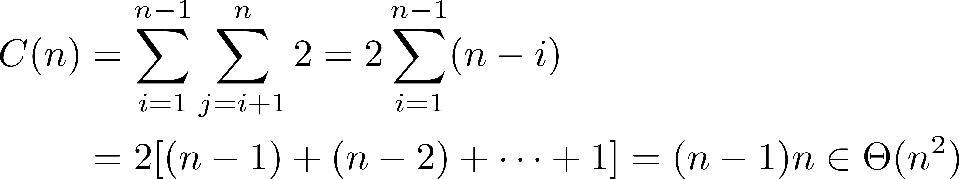
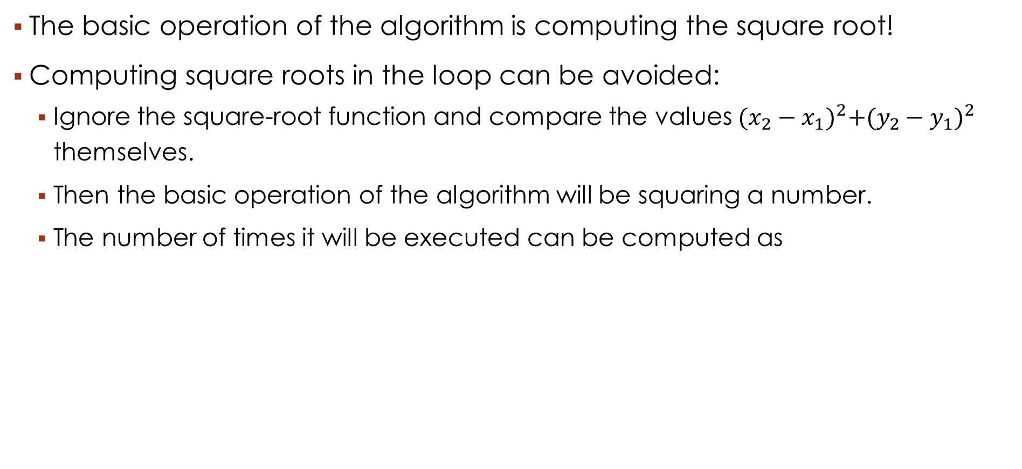
6. closest-pair
The basic operation of the algorithm is computing the square root!
Computing square roots in the loop can be avoided:
Ignore the square-root function and compare the values ${(x_{2}−x_{1})}^{2}+{(y_{2}−y_{1})}^{2}$ themselves.
Then the basic operation of the algorithm will be squaring a number.
The number of times it will be executed can be computed as

Slide 16
7. Exhaustive Search
A brute force solution to a problem involving search for an element with a special property, usually among combinatorial objects such as permutations, combinations, or subsets of a set.
Method:
Generate a list of all potential solutions to the problem in a systematic manner.
Evaluate potential solutions one by one, disqualifying infeasible ones and, for an optimization problem, keeping track of the best one found so far.
When search ends, announce the solution(s) found.

Slide 17

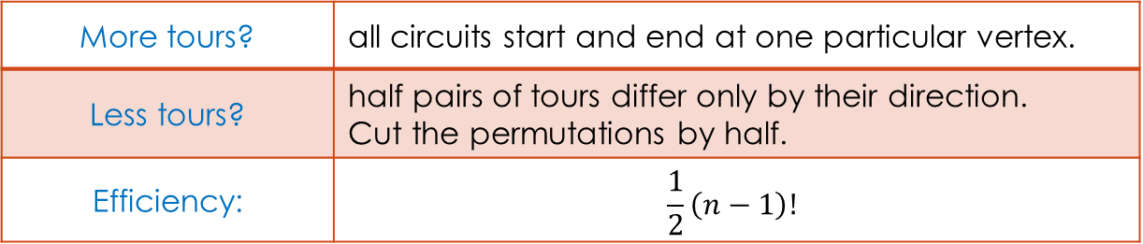
7. Exhaustive Search - Example 1: Traveling Salesman Problem
Given $n$ cities with known distances between each pair, find the shortest tour that passes through all the cities exactly once before returning to the starting city
Example:
Tour | Cost
a → b → c → d → a | 2+3+7+5 = 17
a → b → d → c → a | 2+4+7+8 = 21
a → c → b → d → a | 8+3+4+5 = 20
a → c → d → b → a | 8+7+4+2 = 21
a → d → b → c → a | 5+4+3+8 = 20
a → d → c → b → a | 5+7+3+2 = 17
2
a
b
3
8
5
4
c
d
More tours? | all circuits start and end at one particular vertex.
Less tours? | half pairs of tours differ only by their direction. Cut the permutations by half.
Efficiency: | $$\frac{1}{2}\left(n−1\right)!$$
7

Slide 18
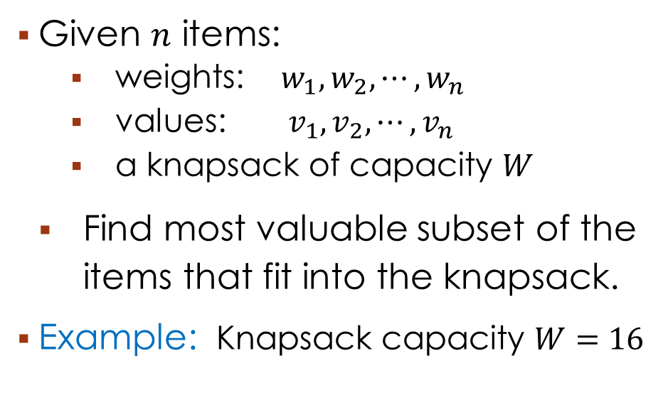
7. Exhaustive Search - Example 2: Knapsack Problem
Given $n$ items:
weights: $w_{1},w_{2},⋯,w_{n}$
values: $v_{1},v_{2},⋯,v_{n}$
a knapsack of capacity $W$
Find most valuable subset of the items that fit into the knapsack.
Example: Knapsack capacity $W=16$
Subset Total weight Total value (BD)
{1} 2 20
{2} 5 30
{3} 10 50
{4} 5 10
{1,2} 7 50
{1,3} 12 70
{1,4} 7 30
{2,3} 15 80
{2,4} 10 40
{3,4} 15 60
{1,2,3} 17 not feasible
{1,2,4} 12 60
{1,3,4} 17 not feasible
{2,3,4} 20 not feasible
{1,2,3,4} 22 not feasible
item | weight | Value (BD)
1 | 2 | 20
2 | 5 | 30
3 | 10 | 50
4 | 5 | 10

Slide 19
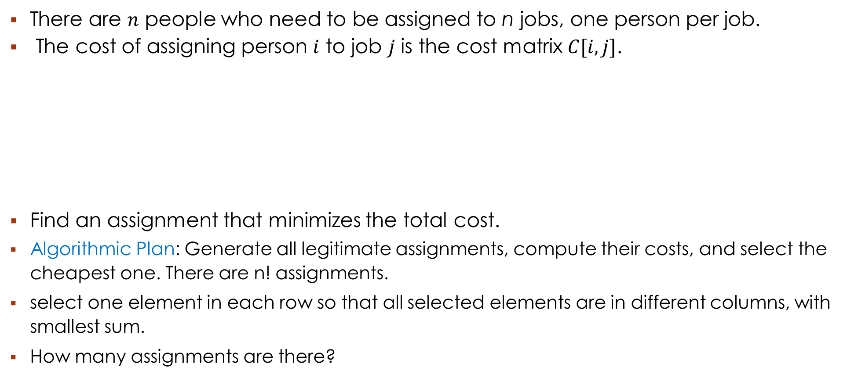
7. Exhaustive Search - Example 3: The Assignment Problem
There are $n$ people who need to be assigned to n jobs, one person per job.
The cost of assigning person $i$ to job $j$ is the cost matrix $C[i,j]$.
Find an assignment that minimizes the total cost.
Algorithmic Plan: Generate all legitimate assignments, compute their costs, and select the cheapest one. There are n! assignments.
select one element in each row so that all selected elements are in different columns, with smallest sum.
How many assignments are there?
 | Job 0 | Job 1 | Job 2 | Job 3
Person 0 | 9 | 2 | 7 | 8
Person 1 | 6 | 4 | 3 | 7
Person 2 | 5 | 8 | 1 | 8
Person 3 | 7 | 6 | 9 | 4

Slide 20

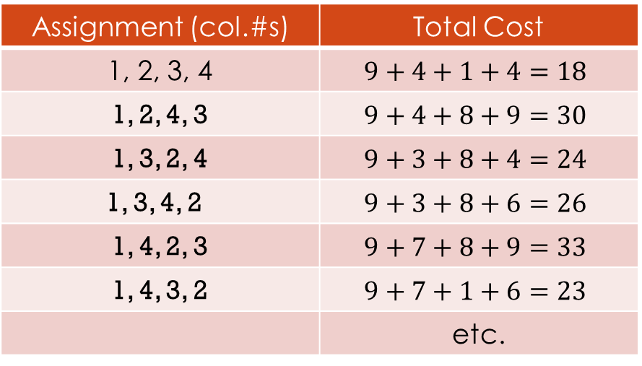
7. Exhaustive Search - Assignment Problem by Exhaustive Search
Example
Exhaustive search is impractical for all but very small instances of the problem.
Assignment (col.#s) | Total Cost
1, 2, 3, 4 | $$9+4+1+4=18$$
1, 2, 4, 3 | $$9+4+8+9=30$$
1, 3, 2, 4 | $$9+3+8+4=24$$
1, 3, 4, 2 | $$9+3+8+6=26$$
1, 4, 2, 3 | $$9+7+8+9=33$$
1, 4, 3, 2 | $$9+7+1+6=23$$
 | etc.
$$C=\left[\begin{matrix}9 & 2 & 7 & 8 \\ 6 & 4 & 3 & 7 \\ 5 & 8 & 1 & 8 \\ 7 & 6 & 9 & 4\end{matrix}\right]$$

